Slide 1



What is Responsive Web Design?
Responsive web design makes your web page look good on all devices.
Responsive web design uses only HTML and CSS.
Responsive web design is not a program or a JavaScript.
Web pages can be viewed using many different devices: desktops, tablets, and phones. Your web page should look good, and be easy to use, regardless of the device.
Web pages should not leave out information to fit smaller devices, but rather adapt its content to fit any device:
Phone
Tablet
Desktop
It is called responsive web design when you use CSS and HTML to resize, hide, shrink, enlarge, or move the content to make it look good on any screen.

Slide 2
<meta> tag
A meta tag is an element that provides information about the metadata of an HTML document. This information could be the keywords, author, page description or any other details about the specific page. Unlike other HTML tags, however, a meta tag is not visible or displayed in the concerned page but is machine parsable.
The <meta> tag defines metadata about an HTML document. Metadata is data (information) about data. <meta> tags always go inside the <head> element, and are typically used to specify character set, page description, keywords, author of the document, and viewport settings.
Metadata is used by browsers (how to display content or reload page), search engines (keywords), and other web services.
There is a method to let web designers take control over the viewport (the user's visible area of a web page), through the <meta> tag

Slide 3
Attributes of <meta> tag
Attribute | Value | Description
charset | character_set | Specifies the character encoding for the HTML document
content | text | Specifies the value associated with the http-equiv or name attribute
http-equiv | content-security-policy content-type default-style refresh | Provides an HTTP header for the information/value of the content attribute
name | application-name author description generator keywords viewport | Specifies a name for the metadata

Slide 4
Examples of <meta> tag
Define keywords for search engines:
<meta name="keywords" content="HTML, CSS, JavaScript">
Define a description of your web page:
<meta name="description" content="Free Web tutorials for HTML and CSS">
Define the author of a page:
<meta name="author" content="John Doe">
Refresh document every 30 seconds:
<meta http-equiv="refresh" content="30">
Setting the viewport to make your website look good on all devices:
<meta name="viewport" content="width=device-width, initial-scale=1.0">

Slide 5
View Port
The viewport is the user's visible area of a web page. The viewport varies with the device, and will be smaller on a mobile phone than on a computer screen. Before tablets and mobile phones, web pages were designed only for computer screens, and it was common for web pages to have a static design and a fixed size.
The browser's viewport is the area of the window in which web content can be seen. This is often not the same size as the rendered page, in which case the browser provides scrollbars for the user to scroll around and access all the content.
The viewport meta tag allows you to simply use max and min-width that span from desktop to mobile devices.
CSS Viewport is defined as the visible area on a window screen which refers to the displays of the mobile devices. Adding CSS <meta> tag with viewport is an efficient way to improve the web pages to look on smaller screens.

Slide 6
Setting The Viewport
HTML5 introduced a method to let web designers take control over the viewport, through the <meta> tag.
You should include the following <meta> viewport element in all your web pages:
<meta name="viewport" content="width=device-width, initial-scale=1.0">
This gives the browser instructions on how to control the page's dimensions and scaling.
The width=device-width part sets the width of the page to follow the screen- width of the device (which will vary depending on the device).
The initial-scale=1.0 part sets the initial zoom level when the page is first loaded by the browser.

Slide 7
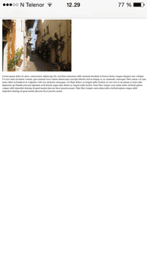
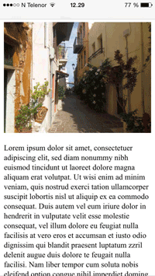
Without viewport meta tag
With the viewport meta tag

Slide 8
CSS Viewport
CSS Viewport is defined as the visible area on a window screen which refers to the displays of the mobile devices.
Adding CSS <meta> tag with viewport is an efficient way to improve the web pages to look on smaller screens. The ViewPort is not the same size as the original Webpage. It is not a standard but still tagged as a key approach for Responsive Web Design.
In simple terms, viewport helps web browsers to break pages and add them on a small screen in a readable format (prevents side scroll).
Syntax and Parameters
@viewport { width: device-width; zoom: 1.1; min-zoom: 0.4; max-zoom: 2; user-zoom: fixed; }

Slide 9
Syntax and Parameters
@viewport { width: device-width; zoom: 1.1; min-zoom: 0.4; max-zoom: 2; user-zoom: fixed; }
Width: It adjusts to the device in a normal or landscape view. It takes values like auto, device-width, device-height, length, percentage. And width sets shorthand properties namely max and min-width.
Zoom: It sets for zooming by giving initial-scale in the meta tag. Even this control min and max zoom factor. A zoom factor 1.0 or 100% implies no zooming. Here the larger values make zoom in and smaller values do zoom out.
In HTML document
<meta name="viewport" content="width=device-width, initial-scale=1">
This is the general format of Viewport used in different mobile-optimized Websites. Well, Here the meta viewport tag has to do some settings for changing the scale point of the viewport.

Slide 10
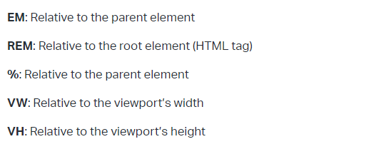
Responsive Web Design
Responsive web design is broken down into three main components, including flexible layouts, media queries, and flexible media.
The first part, flexible layouts, is the practice of building the layout of a website with a flexible grid, capable of dynamically resizing to any width.
Flexible grids are built using relative length units, most commonly percentages or em units.
These relative lengths are then used to declare common grid property values such as width, margin, or padding.
Relative Viewport Lengths
CSS3 introduced some new relative length units, specifically related to the viewport size of the browser or device. These new units include vw, vh, vmin, and vmax. Overall support for these new units isn’t great, but it is growing. In time they look to play a large roll in building responsive websites.
vw vh
Viewports width Viewports height
vmin Minimum of the viewport’s height and width
vmax Maximum of the viewport’s height and width

Slide 11
Relative Viewport Lengths
Absolute Lengths
The absolute length units are fixed and a length expressed in any of these will appear as exactly that size.
Absolute length units are not recommended for use on screen, because screen sizes vary so much. However, they can be used if the output medium is known, such as for print layout.
Unit | Description
cm | centimetersTry it
mm | millimetersTry it
in | inches (1in = 96px = 2.54cm)Try it
px * | pixels (1px = 1/96th of 1in)Try it
pt | points (1pt = 1/72 of 1in)Try it
pc | picas (1pc = 12 pt)

Slide 12
<head>
<style>
h1 {font-size: 1.5cm;}
h2 {font-size: 1cm;}
p {
font-size: 0.5cm;
line-height: 1cm;
}
</style>
</head>
<head>
<style>
h1 {font-size: 15mm;}
h2 {font-size: 10mm;}
p {
font-size: 5mm;
line-height: 10mm;
}
</style>
</head>
<head>
<style>
h1 {font-size: 1in;}
h2 {font-size: 0.5in;}
p {
font-size: 0.2in;
line-height: 0.5in;
}
</style>
</head>
<head>
<style>
h1 {font-size: 50px;}
h2 {font-size: 30px;}
p {
font-size: 15px;
line-height: 20px;
}
</style>
</head>
<head>
<style>
h1 {font-size: 50pt;}
h2 {font-size: 25pt;}
p {
font-size: 15pt;
line-height: 25pt;
}
</style>
</head>
<head>
<style>
h1 {font-size: 4.5pc;}
h2 {font-size: 3pc;}
p {
font-size: 1.5pc;
line-height: 3pc;
}
</style>
</head>
Pixels (px) are relative to the viewing device. For low-dpi devices, 1px is one device pixel (dot) of the display. For printers and high resolution screens 1px implies multiple device pixels.

Slide 13
Relative Lengths
Relative length units specify a length relative to another length property. Relative length units scale better between different rendering medium.
Unit | Description
em | Relative to the font-size of the element (2em means 2 times the size of the current font) | Try it
ex | Relative to the x-height of the current font (rarely used) | Try it
ch | Relative to the width of the "0" (zero) | Try it
rem | Relative to font-size of the root element | Try it
vw | Relative to 1% of the width of the viewport* | Try it
vh | Relative to 1% of the height of the viewport* | Try it
vmin | Relative to 1% of viewport's* smaller dimension | Try it
vmax | Relative to 1% of viewport's* larger dimension | Try it
% | Relative to the parent element

Slide 14
<head>
<style>
p {
font-size: 16px;
line-height: 2em;
}
div {
font-size: 30px;
border: 1px solid black;
}
span {
font-size: 0.5em;
}
</style>
</head>
<head>
<style>
div {
font-size: 30px;
border: 1px solid black;
}
span {
font-size: 1ex;
}
</style>
</head>

Slide 15
<head>
<style>
body {
font-size:16px;
}
div {
font-size: 3ch;
border: 1px solid black;
}
</style>
</head>
<head>
<style>
html {
font-size:16px;
}
div {
font-size: 3rem;
border: 1px solid black;
}
#top-div {
font-size: 2rem;
border: 1px solid red;
}
</style>
</head>

Slide 16
<head>
<style>
h1 {
font-size: 20vw;
}
</style>
</head>
<body>
<head>
<style>
h1 {
font-size: 20vh;
}
</style>
</head>
<head>
<style>
h1 {
font-size: 15vmin;
}
</style>
</head>
<head>
<style>
body {
font-size:16px;
}
div {
font-size: 150%;
border: 1px solid black;
}
</style>
</head>
<head>
<style>
h1 {
font-size: 15vmax;
}
</style>
</head>
The em and rem units are practical in creating perfectly scalable layout! * Viewport = the browser window size. If the viewport is 50cm wide, 1vw = 0.5cm.

Slide 17
Responsive Web Design
Flexible layouts do not advocate the use of fixed measurement units, such as pixels or inches.
Reason being, the viewport height and width continually change from device to device. Website layouts need to adapt to this change and fixed values have too many constraints.
Fortunately, Ethan pointed out an easy formula to help identify the proportions of a flexible layout using relative values.
The formula is based around taking the target width of an element and dividing it by the width of it’s parent element. The result is the relative width of the target element.
target ÷ context = result

Slide 18
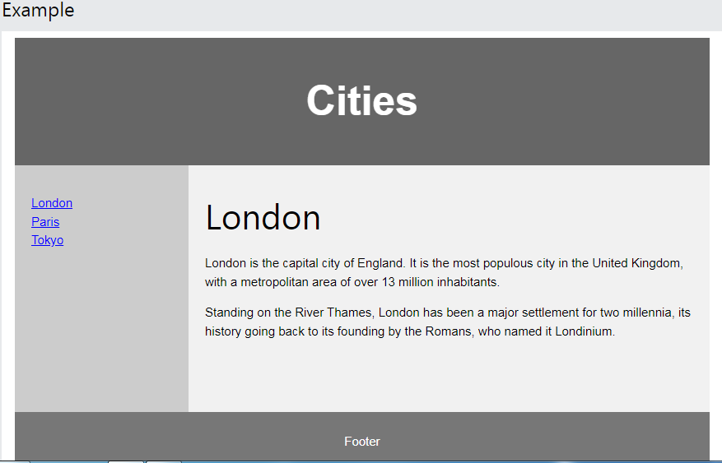
HTML Layout Elements and Techniques
Websites often display content in multiple columns (like a magazine or a newspaper)

Slide 19
In this example, we have created a header, two columns/boxes and a footer. On smaller screens, the columns will stack on top of each other.
<!DOCTYPE html>
<html lang="en">
<head>
<title>CSS Template</title>
<meta charset="utf-8">
<meta name="viewport" content="width=device-width, initial-scale=1">
<style>
* {
box-sizing: border-box;
}
body {
font-family: Arial, Helvetica, sans-serif;
}
/* Style the header */
header {
background-color: #666;
padding: 30px;
text-align: center;
font-size: 35px;
color: white;
}

Slide 20
/* Create two columns/boxes that floats next to each other */
nav {
float: left;
width: 30%;
height: 300px; /* only for demonstration, should be removed */
background: #ccc;
padding: 20px;
}
/* Style the list inside the menu */
nav ul {
list-style-type: none;
padding: 0;
}
article {
float: left;
padding: 20px;
width: 70%;
background-color: #f1f1f1;
height: 300px; /* only for demonstration, should be removed */
}

Slide 21
/* Clear floats after the columns */
section::after {
content: "";
display: table;
clear: both;
}
/* Style the footer */
footer {
background-color: #777;
padding: 10px;
text-align: center;
color: white;
}
/* Responsive layout - makes the two columns/boxes stack on top of each other instead of next to each other, on small screens */
@media (max-width: 600px) {
nav, article {
width: 100%;
height: auto;
}
}
</style> </head> <body>

Slide 22
<header>
<h2>Cities</h2>
</header>
<section>
<nav>
<ul>
<li><a href="#">London</a></li>
<li><a href="#">Paris</a></li>
<li><a href="#">Tokyo</a></li>
</ul>
</nav>

Slide 23
<article>
<h1>London</h1>
<p>London is the capital city of England. It is the most populous city in the United Kingdom, with a metropolitan area of over 13 million inhabitants.</p>
<p>Standing on the River Thames, London has been a major settlement for two millennia, its history going back to its founding by the Romans, who named it Londinium.</p>
</article>
</section>
<footer>
<p>Footer</p>
</footer>
</body>
</html>

Slide 24
Semantic and Non-semantic elements
HTML tags are classified in two types.
Semantic and Non-Semantic
Semantic Elements: Semantic elements have meaningful names which tells about type of content. For example header, footer, table, … etc. HTML5 introduces many semantic elements as mentioned below which make the code easier to write and understand for the developer as well as instructs the browser on how to treat them.
article
aside
details
figcaption
figure
footer
header
main
mark
nav
section
Article: It contains independent content which does not require any other context.

Slide 25
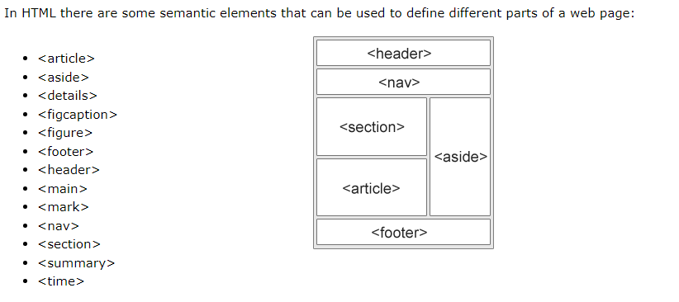
Semantic and Non-semantic elements
Non-Semantic Elements: Tags like div, span fall under the Non- Semantic categories as their names don’t tell anything about what kind of content is present inside them. div It is a block level element or division of a section. It is used as a container.
Try different examples of both

Slide 26
HTML Layout Techniques
There are four different techniques to create multicolumn layouts. Each technique has its pros and cons:
CSS framework (All popular CSS Frameworks offer responsive design)
CSS float property
CSS flexbox
CSS grid
CSS Frameworks
If you want to create your layout fast, you can use a CSS framework, like W3.CSS or Bootstrap.
CSS Float Layout
It is common to do entire web layouts using the CSS float property. Float is easy to learn - you just need to remember how the float and clear properties work.
CSS Flexbox Layout
Use of flexbox ensures that elements behave predictably when the page layout must accommodate different screen sizes and different display devices.
CSS Grid Layout
The CSS Grid Layout Module offers a grid-based layout system, with rows and columns, making it easier to design web pages without having to use floats and positioning.

Slide 27
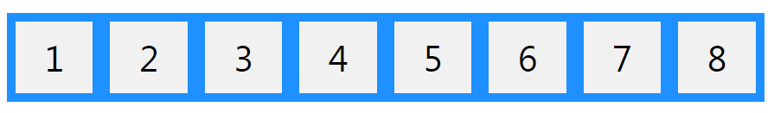
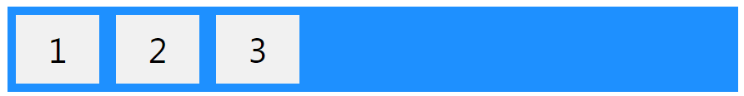
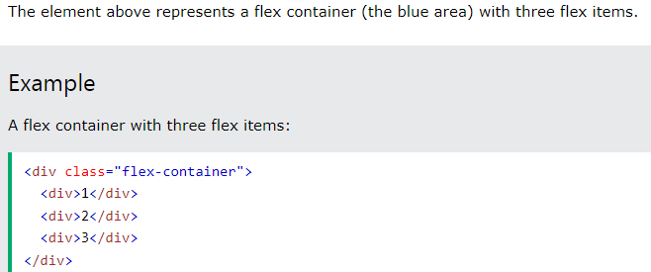
CSS Flexbox
Flexbox Elements
To start using the Flexbox model, you need to first define a flex container.

Slide 28
Flexbox
The Flexbox Layout (Flexible Box) module (a W3C Candidate Recommendation as of October 2017) aims at providing a more efficient way to lay out, align and distribute space among items in a container, even when their size is unknown and/or dynamic (thus the word “flex”).
A flex container expands items to fill available free space or shrinks them to prevent overflow.
While those work well for pages, they lack flexibility (no pun intended) to support large or complex applications (especially when it comes to orientation changing, resizing, stretching, shrinking, etc.).
Flexbox layout is most appropriate to the components of an application, and small-scale layouts, while the Grid layout is intended for larger scale layouts.
Since flexbox is a whole module and not a single property, it involves a lot of things including its whole set of properties. Some of them are meant to be set on the container (parent element, known as “flex container”) whereas the others are meant to be set on the children (said “flex items”).

Slide 29
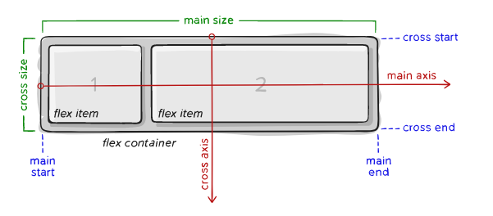
main axis – The main axis of a flex container is the primary axis along which flex items are laid out. Beware, it is not necessarily horizontal; it depends on the flex-direction property
main-start | main-end – The flex items are placed within the container starting from main-start and going to main-end.
main size – A flex item’s width or height, whichever is in the main dimension, is the item’s main size. The flex item’s main size property is either the ‘width’ or ‘height’ property, whichever is in the main dimension.

Slide 30
cross axis – The axis perpendicular to the main axis is called the cross axis. Its direction depends on the main axis direction.
cross-start | cross-end – Flex lines are filled with items and placed into the container starting on the cross-start side of the flex container and going toward the cross-end side.
cross size – The width or height of a flex item, whichever is in the cross dimension, is the item’s cross size. The cross size property is whichever of ‘width’ or ‘height’ that is in the cross dimension.

Slide 31
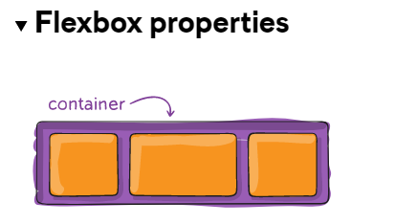

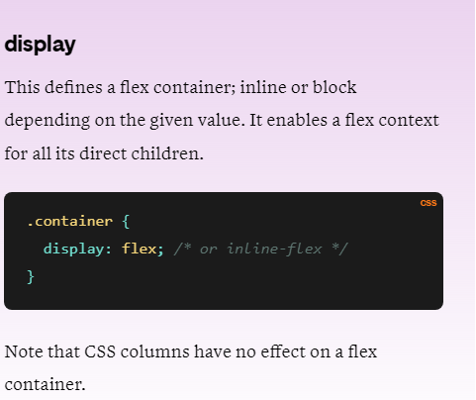

Slide 32
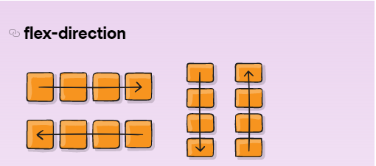
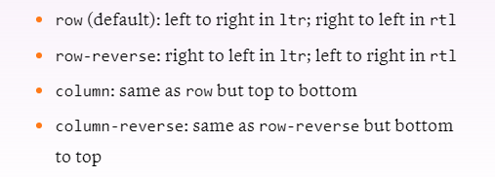
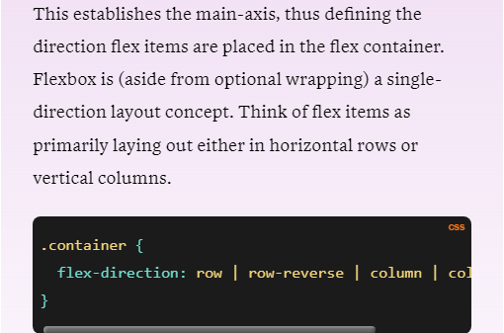

Slide 33
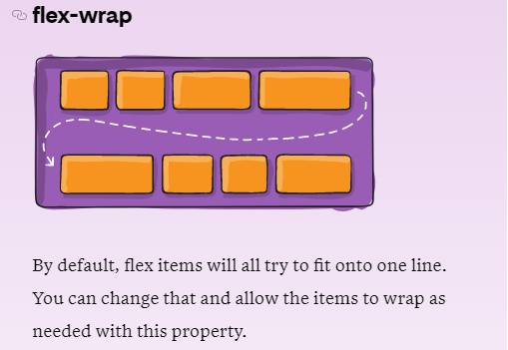
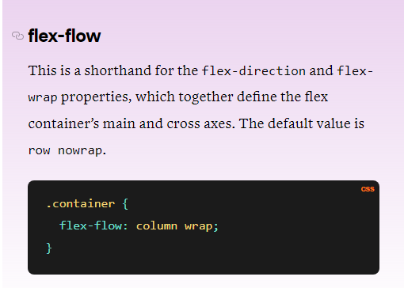
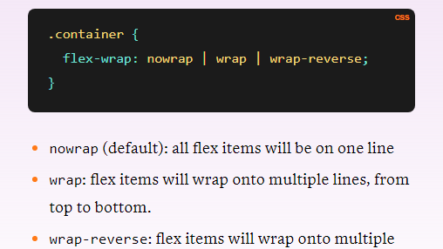

Slide 34
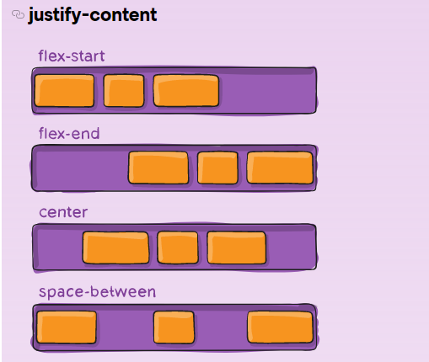
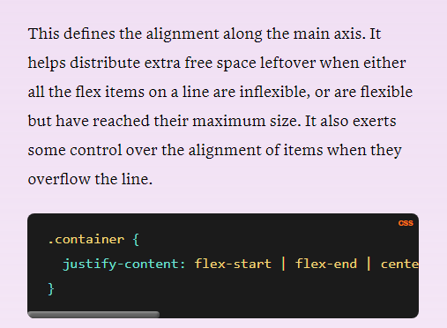
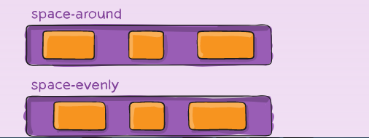

Slide 35
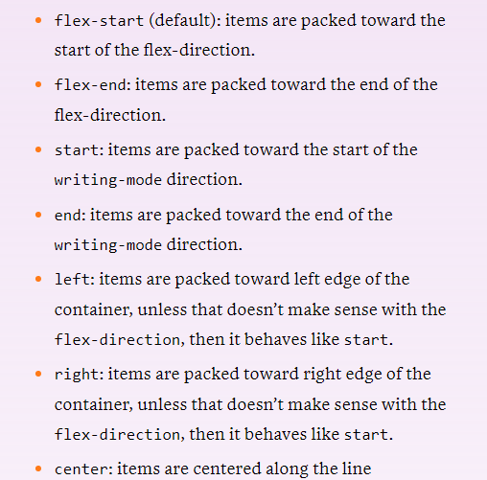
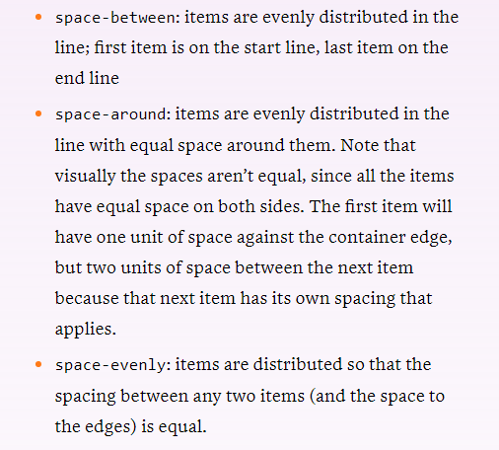

Slide 36
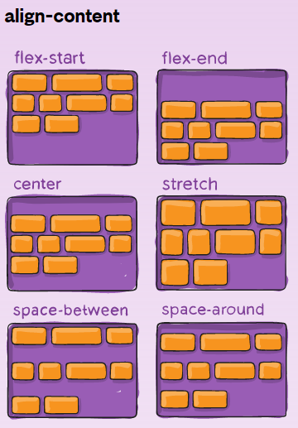
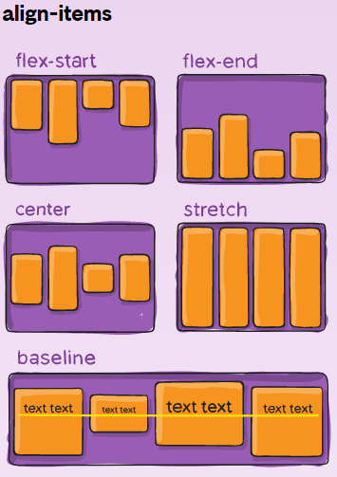
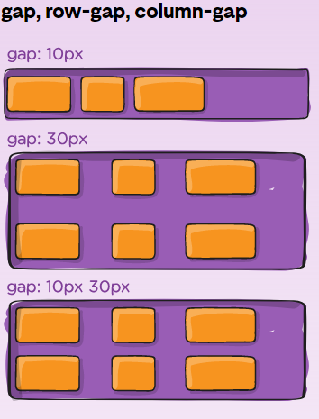
Reference:
https://css-tricks.com/snippets/css/a-guide-to-flexbox/

Slide 37
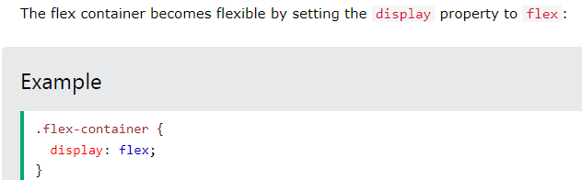
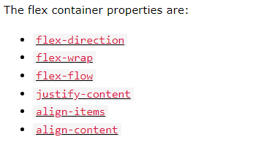
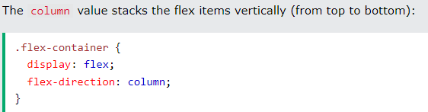
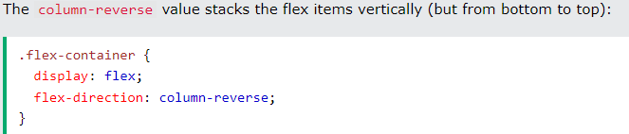
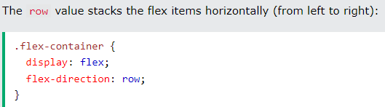

Slide 38
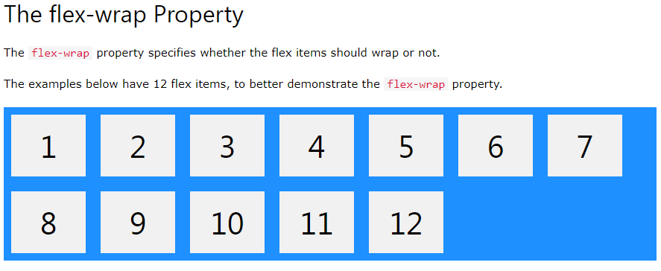
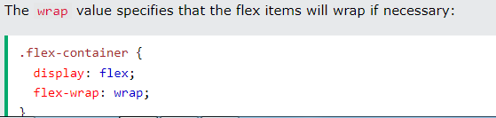
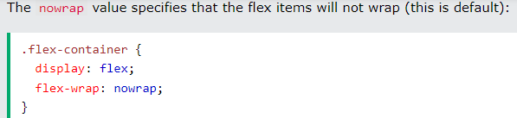

Slide 39
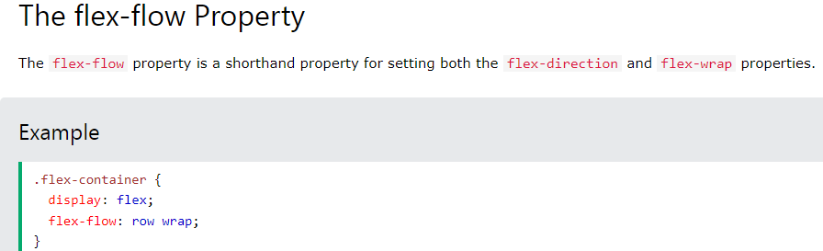
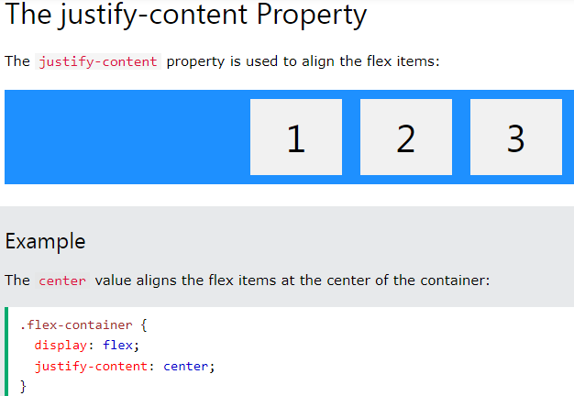

Slide 40
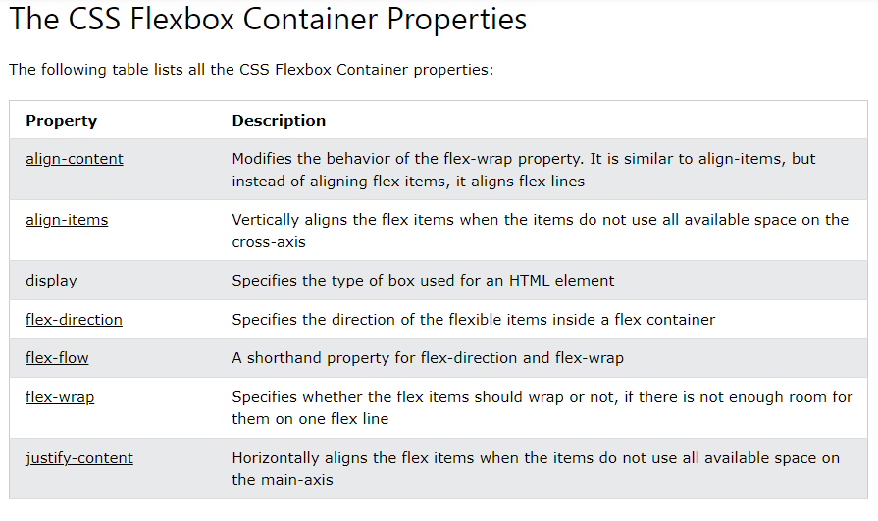

Slide 41
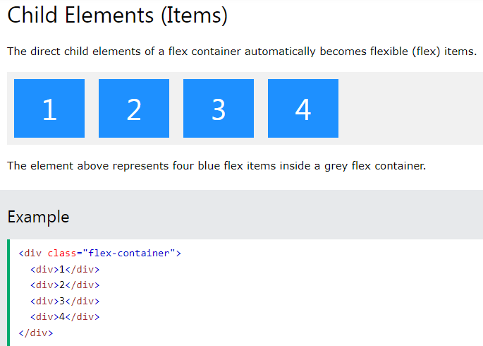
The flex item properties are:
order
flex-grow
flex-shrink
flex-basis
flex
align-self

Slide 42
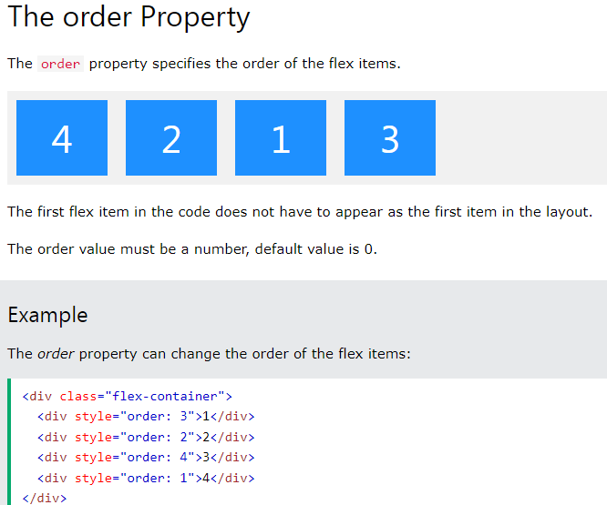

Slide 43
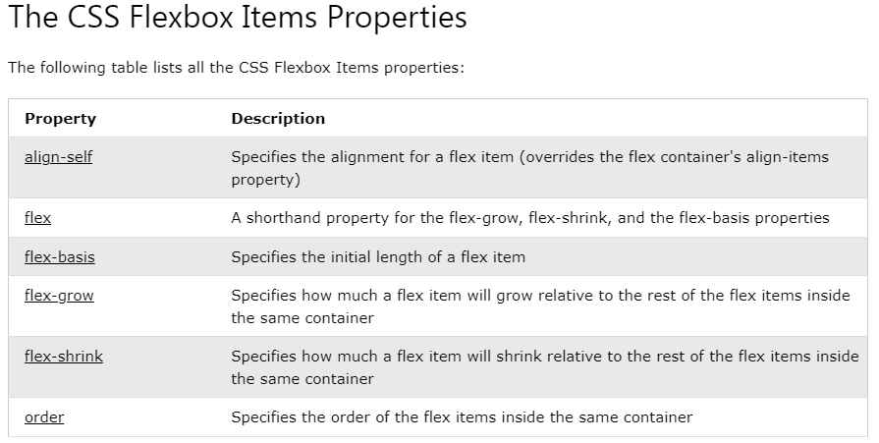

Slide 44
<!DOCTYPE html>
<html>
<head>
<style>
.flex-container {
display: flex;
flex-wrap: nowrap;
background-color: DodgerBlue;
}
.flex-container > div {
background-color: #f1f1f1;
width: 100px;
margin: 10px;
text-align: center;
line-height: 75px;
font-size: 30px;
}
</style>
</head>

Slide 45
<body>
<h1>Flexible Boxes</h1>
<div class="flex-container">
<div>1</div>
<div>2</div>
<div>3</div>
<div>4</div>
<div>5</div>
<div>6</div>
<div>7</div>
<div>8</div>
</div>
<p>Try to resize the browser window.</p>
<p>A container with "flex-wrap: nowrap;" will never wrap its items.</p>
<p><strong>Note:</strong> Flexbox is not supported in Internet Explorer 10 or earlier versions.</p>
</body>
</html>

Slide 46
The Building Blocks of Responsive Web Design
CSS and HTML
Media Queries
Fluid Layouts
Flexbox Layout
Responsive Images
CSS and HTML
HTML mainly controls the structure, elements, and content of a webpage. For example, to add an image to a website, you have to use HTML code like this:
<img src="image.gif" alt="image" class=”full-width-img”>
You can set a “class” or “id” that you can later target with CSS code.
You could also control primary attributes such as height and width within your HTML, but this is no longer considered best practice.
Instead, CSS is used to edit the design and layout of the elements you include on a page with HTML. CSS code can be included in a <style> section of a HTML document, or as a separate stylesheet file.
For example, we could edit the width of all HTML images at the element level like this:
img { width: 100%; }
Or we could target the specific class “full-width-img” by adding a period in front.
.full-width-img { width: 100%; }

Slide 47
The Building Blocks of Responsive Web Design
CSS and HTML
Media Queries
Fluid Layouts
Flexbox Layout
Responsive Images
Media Queries
You can also control the design beyond just height, width, and color.
Using CSS like this is how you make a design responsive when you combine it with a technique called media query.
A media query is a fundamental part of CSS3 that lets you render content to adapt to different factors like screen size or resolution.
It works in a similar way to an “if clause” in some programming languages, basically checking if a screen’s viewport is wide enough or too wide before executing the appropriate code.
@media screen and (min-width: 780px) {
.full-width-img {
margin: auto;
width: 90%;
}
If the screen is at least 780 pixels wide, “full-width-img” class images will take up 90% of the screen and be automatically centered by equally wide margins.

Slide 48
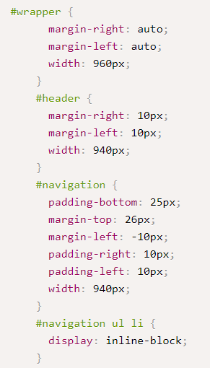
<div id="wrapper">
<!-- the header and navigation -->
<div id="header">
<div id="navigation">
<ul>
<li><a href="#">navigation1</a></li>
<li><a href="#">navigation2</a></li>
</ul>
</div>
</div>
</div>
We need to set a proportional value for the width that the #wrapper should be in relation to the viewport size.
#wrapper {
margin-right: auto;
margin-left: auto;
width: 96%; /* Holding outermost DIV */ }
Consider the formula again: target ÷ context = result. Our #header div (the target) sits within the #wrapper div (the context). Therefore, we take our #header (the target) width of 940 pixels, divide it by the width of the context (the #wrapper), which was 960 px, and the result is .979166667. We can turn this into a percentage by moving the decimal place two digits to the right and we now have a percentage width for the header of 97.9166667.

Slide 49
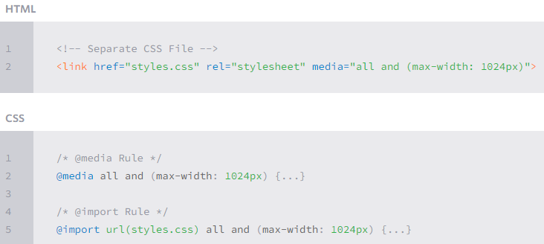
Media Queries (Contd..)
Media queries were built as an extension to media types commonly found when targeting and including styles.
Media queries provide the ability to specify different styles for individual browser and device circumstances, the width of the viewport or device orientation for example.
Initializing Media Queries
There are a couple different ways to use media queries, using the @media rule inside of an existing style sheet, importing a new style sheet using the @import rule, or by linking to a separate style sheet from within the HTML document.
Generally speaking it is recommend to use the @media rule inside of an existing style sheet to avoid any additional HTTP requests.

Slide 50
Media Queries (Contd..)
Each media query may include a media type followed by one or more expressions.
Common media types include all, screen, print, tv, and braille.
The HTML5 specification includes new media types, even including 3d-glasses. Should a media type not be specified the media query will default the media type to screen. (as seen in the previous example)
The media query expression that follows the media type may include different media features and values, which then allocate to be true or false.
When a media feature and value allocate to true, the styles are applied. If the media feature and value allocate to false the styles are ignored.
Logical Operators in Media Queries
Logical operators in media queries help build powerful expressions.
There are three different logical operators available for use within media queries, including and, not, and only.
Using the and logical operator within a media query allows an extra condition to be added, making sure that a browser or devices does both a, b, c, and so forth. Multiple individual media queries can be comma separated, acting as an unspoken or operator. The example below selects all media types between 800 and 1024 pixels wide.
@media all and (min-width: 800px) and (max-width: 1024px) {...}

Slide 51
Logical Operators in Media Queries (Contd..)
The not logical operator negates the query, specifying any query but the one identified. In the example below the expression applies to any device that does not have a color screen. Black and white or monochrome screens would apply here for example.
@media not screen and (color) {...}
The only logical operator is a new operator and is not recognized by user agents using the HTML4 algorithm, thus hiding the styles from devices or browsers that don’t support media queries. Below, the expression selects only screens in a portrait orientation that have a user agent capable of rending media queries.
@media only screen and (orientation: portrait) {...}
Omitting a Media Type
When using the not and only logical operators the media type may be left off. In this case the media type is defaulted to all.

Slide 52
Flexible Media
The final, equally important aspect to responsive web design involves flexible media.
As viewports begin to change size media doesn’t always follow suit. Images, videos, and other media types need to be scalable, changing their size as the size of the viewport changes.
One quick way to make media scalable is by using the max-width property with a value of 100%.
Doing so ensures that as the viewport gets smaller any media will scale down according to its containers width.
img, video, canvas {
max-width: 100%;
}

Slide 53
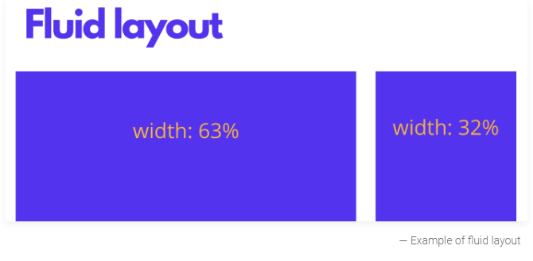
The Building Blocks of Responsive Web Design
CSS and HTML
Media Queries
Fluid Layouts
Flexbox Layout
Responsive Images
Speed
Fluid Layouts
A fluid layout is an essential part of modern responsive design. In the good old days, you would set a static value for every HTML element, like 600 pixels.
A fluid layout relies instead on dynamic values like a percentage of the viewport width.
Example: Previous example

Slide 54
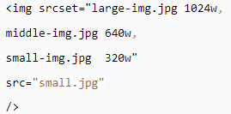
The Building Blocks of Responsive Web Design
CSS and HTML
Media Queries
Fluid Layouts
Flexbox Layout
Responsive Images
Responsive Images
The most basic iteration of responsive images follows the same concept as a fluid layout, using a dynamic unit to control the width or height. The sample CSS code we covered earlier already accomplishes this:
img {
width: 100%;
}
The % unit approximates to a single percentage of the width or height of the viewport and makes sure the image remains in proportion to the screen.
The problem with this approach is that every user has to download the full-sized image, even on mobile.
To serve different versions scaled for different devices, you need to use the HTML srcset attribute in your img tags, to specify more than one image size to choose from.

Slide 55
The Building Blocks of Responsive Web Design
CSS and HTML
Media Queries
Fluid Layouts
Flexbox Layout
Responsive Images
Speed
Flexbox Layout
While a percentage-based layout is fluid, many designers and web developers felt it was not dynamic or flexible enough.
Flexbox is a CSS module designed as a more efficient way to lay out multiple elements, even when the size of the contents inside the container is unknown.
A flex container expands items to fill available free space or shrinks them to prevent overflow. These flex containers have a number of unique properties, like justify-content, that you can’t edit with a regular HTML element.

Slide 56
Media Queries:
Media Features:
https://css-tricks.com/a-complete-guide-to-css-media-queries/
https://www.w3.org/TR/mediaqueries-3/

Slide 57
What is Mobile-First Design?
As the term suggests, mobile-first design is an approach in which web designers start product design for mobile devices first.
This can be done by sketching or prototyping the web app’s design for the smallest screen first and gradually working up to larger screen sizes.
Prioritizing design for mobiles makes sense as there are space limitations in devices with smaller screen sizes and teams need to ensure that the key elements of the website are prominently displayed for anyone using those screens.
Designing and developing for small screens compels designers to remove anything that isn’t necessary for seamless website rendering and navigation.

Slide 58
How Mobile-First Design Strategy Came To Be?
Earlier, websites were often developed with the assumption that they would be primarily accessed from desktops.
Eventually, developers made an attempt to modify these websites by cutting down some functions to enhance browsing on mobile or tablet devices.
This approach of scaling down the websites is popularly known as Graceful Degradation or Desktop-First approach.
A downside to this approach is that several web elements do not adapt well to smaller screen sizes. Consequently, this degrades the visual appearance of websites on smaller devices.
To address this problem, developers came up with another approach – Progressive Advancement or Mobile-First Design.
A mobile-first approach encouraged designers to begin the website designing process for the smallest devices first and then add more functionalities for bigger screen sizes.

Slide 59
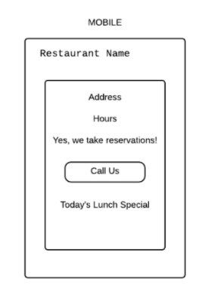
How to Implement Mobile-First Approach in Product Design?
Let’s assume a web designer needs to work on a website for a restaurant. Since the designer needs to follow the mobile-first approach, they must think about what a user will expect from a restaurant website on a mobile device.
Designers must identify the primary things that an end-user is looking for while accessing a restaurant website on a mobile device. Given the user is on mobile, it would be safe to assume that they are mainly searching for – operating hours, exact location, and contact details (or click to call button given it’s mobile). On the basis of these assumptions, the page can be designed precisely as follows.

Slide 60
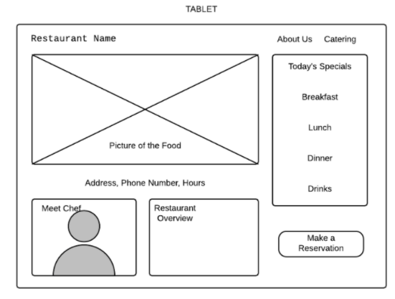
In the case of tablets, users have more space and probably more time to explore the website. Designers can leverage this by adding more functionalities or information regarding the food menu (images), or chef details as displayed below:

Slide 61
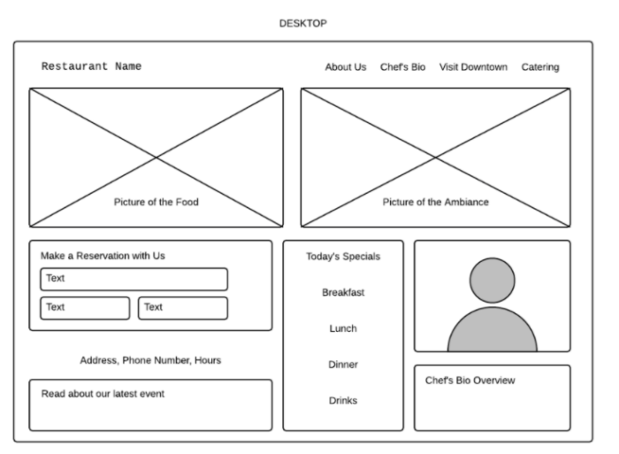
When it comes to desktops, web designers have all the required space to showcase more details. These details can include blog posts, images of party events recently hosted, the ambiance, or contact forms to promote the restaurant better.

Slide 62
Best Practices for The Mobile-First Approach
For complex and layered designs, web designers UI/UX experts must bear in mind the following best practices to ensure a mobile-first approach effectively:
1. Prioritize Page Content
When it comes to mobile-first design, designers must bear in mind the fact that content is the key. As there are space restrictions on smaller screens, web designers must ensure that the most critical elements are prominently displayed since those are the ones users will actively look for.
2. Deliver Intuitive Navigation
Intuitive navigation is of utmost importance when it comes to delivering a neat and clean user experience on mobile devices. Web designers can leverage features like navigation drawers (using Hamburger menus) to display secondary elements of the website. This will help users to find the necessary information easily.
Speed and intuitiveness go hand in hand. SpeedLab by BrowserStack instantly provides you Page Speed Score out of 100 for both Desktop and Mobile platforms. With these insights, your design team can optimize for a mobile-friendly interface across different mobile devices and browsers.

Slide 63
3. Avoid Disruptive Pop-ups
As mentioned frequently, mobile devices have space constraints and no user likes to be accosted with sudden pop-ups or advertisements taking over the screen. Website owners or designers must only focus on what’s important for users and provide them with the things they are looking for in the first place.
4. Test on Real Devices Under Real Conditions
The most effective way of ensuring that a website delivers optimal user experiences across devices is by testing them on real devices. This helps designers verify whether the website renders as expected across mobiles, tablets, and desktops. BrowserStack’s real device cloud provides teams and individual testers with 3000+ real devices and browsers for instant testing in real user conditions.
How to run a responsive test on BrowserStack?
Enter the URL of the website that is being tested.
Once you sign in, you can enter the website URL and click Check to test responsiveness.
When a particular device is selected, the user will get a view of what the site looks like on it.
Browser Stack Website - Responsive Design Testing on Real Devices
https://www.browserstack.com/responsive

Slide 64
References: (for ‘Mobile first concept’)
https://css-tricks.com/how-to-develop-and-test-a-mobile-first-design-in-2021/
https://www.browserstack.com/guide/how-to-implement-mobile-first-design#:~:text=Mobile%2DFirst%20Approach-,What%20is%20Mobile%2DFirst%20Design%3F,up%20to%20larger%20screen%20sizes.
https://medium.com/@Vincentxia77/what-is-mobile-first-design-why-its-important-how-to-make-it-7d3cf2e29d00

